Slide 1
IMPLEMENTATION OF A FINE-TUNED AI MODEL FOR AN AI BASED SUPPORT SYSTEM IN LEARNING PLATFORMS
GUIDED BY :
DR. VIVEKA T
TEACHING FELLOW
COMPUTER SCIENCE AND ENGINEERING UNIVERSITY COLLEGE OF ENGINEERING , NAGERCOIL
PRESENTED BY:
SARAN S V - (962821104082)
VARSHA HEROLIN A P - (962821104101)
ABINANTH S - (962821104314)
BRITHIKSHA N V - (962821104704)
FINAL YEAR,
COMPUTER SCIENCE AND ENGINEERING
UNIVERSITY COLLEGE OF ENGINEERING , NAGERCOIL
INDUSTRY MENTOR :
MR. NARENDRA HARISH
PRODUCT DESIGNER
AGILETRIBERS,NAGERCOIL

Slide 2
OVERVIEW
ABSTRACT
INTRODUCTION
LITERATURE REVIEW
SUMMARY OF LITERATURE REVIEW
PROPOSED SYSTEM
ARCHITECTURAL DIAGRAM
MODULAR DIAGRAM
TECHNIQUES
PSEUDOCODE
EXPECTED RESULTS
COMPARISON WITH EXISTING SYSTEMS
CONCLUSION AND FUTURE WORKS
REFERENCES

Slide 3
ABSTRACT
The rise of virtual learning platforms has exposed a critical gap in real-time, adaptive, and personalized support, as traditional systems rely on static content and predefined responses. Traditional platforms often fail to address unique learner queries, provide contextual guidance, and deliver timely feedback, leading to disengagement and ineffective learning. To overcome this, an AI-powered support system enhances learning engagement, task evaluation, and real-time assistance using advanced natural language processing (NLP) and automated assessment models. Built with React (frontend) and Python (backend), the platform integrates fine-tuned AI models, GPT-based conversational guidance, and contextual knowledge retrieval to provide instant query resolution, intelligent hints, and automated feedback.

Slide 4
INTRODUCTION
Artificial Intelligence (AI) is transforming education by automating instructional tasks and enabling personalized learning experiences.
Traditional e-learning platforms often lack real-time adaptability and contextual feedback mechanisms.
The project proposes integrating a fine-tuned AI model into learning platforms to bridge this gap.
The model is designed to understand educational context and respond intelligently to student queries.
It aims to mimic human tutors, providing support that is adaptive, interactive, and context-aware.
The system uses natural language understanding (NLU) to support multilingual and inclusive learning environments.

Slide 5
LITERATURE REVIEW
S. NO. | RESEARCH TITLE AND AUTHOR(S) | SUMMARY | KEY FEATURES | LIMITATIONS
1 | AI Based Examination System: A Paradigm Shift in Education Sector B. Galhotra and D. Lowe | Discusses the transformative role of AI in modernizing assessment methods in education. | Automates test generation, invigilation, and evaluation using NLP, image recognition, ML. Intelligent proctoring to prevent cheating. Adaptive testing adjusts difficulty based on student performance. | Data privacy, infrastructure requirements, algorithmic fairness.
2 | AI-Based Personalized E-Learning Systems: Issues, Challenges, and Solutions M. Murtaza, Y. Ahmed, J. A. Shamsi, F. Sherwani and M. Usman | Explores the growing impact of AI in shaping personalized e-learning environments, examining how AI tailors learning experiences. | Recommendation engines, intelligent tutoring systems, predictive analytics for adaptive learning. Enhanced engagement, improved learner outcomes, scalable education delivery. | Data privacy, accuracy of personalization algorithms, scalability, content adaptation, digital divide.

Slide 6
3 | AI-Powered Personalized Learning System Design: Student Engagement And Performance Tracking System A. K. Rekha et al. | Explores AI integration to enhance personalized learning, focusing on designing a system that dynamically adapts to individual student needs and tracks engagement. | Intelligent content recommendation, automated performance evaluation, continuous feedback mechanisms. Dynamically adapts to student needs, learning pace, and performance. | Not explicitly stated in the provided abstract.
4 | AI-Powered Student Learning System A. Sabar, S. Gamage, S. Abishek, C. Lakmal, K. A. D. T. Kulawansa and P. Perera | Introduces an intelligent learning platform designed to enhance student education using AI. | Leverages NLP, ML, and real-time data analytics for adaptive learning paths. AI-based recommendation engine for study materials, quizzes, and feedback. Continuous assessment, timely interventions, automated support. | Not explicitly stated in the provided abstract.
5 | A Review of Artificial Intelligence in Education A. E. Ubah et al. | Provides a comprehensive overview of the role and impact of AI in modern educational systems. | Personalized learning, intelligent tutoring systems, automated grading, data-driven decision-making. Integration of AI with educational platforms to adapt content delivery. | Ethical concerns, data privacy, algorithmic bias, digital divide.
6 | Artificial Intelligence Models for Assessing the Evaluation Process of Complex Student Projects J. Divasón, F. J. Martínez-de-Pisón, A. Romero and E. Sáenz-de-Cabezón | Explores the use of AI to improve the fairness and consistency of assessing complex student projects. | Machine learning models decision trees, SVM, neural networks to identify patterns, predict outcomes, and ensure consistent grading. | Transparency and explainability in AI models are important for trust.

Slide 7
7 | A Study on Role of Artificial Intelligence in Education B. F. Mon, A. Wasfi, M. Hayajneh and A. Slim | Investigates the multifaceted impact of AI on the education sector. | Personalized learning, intelligent tutoring systems, automated grading, enhanced student engagement. Tailored learning experiences, improved efficiency and outcomes. | Data privacy concerns, ethical considerations, digital divide.
8 | Fine-Tuning Large Language Models in Education Y. Chen, H. Chen and S. Su | Investigates the application of large language models LLMs in education, focusing on fine-tuning for teaching and learning objectives. | Enhances student learning through intelligent tutoring, automated feedback, personalized content delivery, and natural language interactions. Context-aware responses aligned with curriculum. | Bias, data privacy, model interpretability.
9 | Intelligent Practices of Large Language Models in Digital Government Services J. Han, J. Lu, Y. Xu, J. You, and B. Wu | Explores the integration and application of LLMs in intelligent digital government services. | Automated citizen interaction, document summarization, multilingual translation, knowledge retrieval. Enables accessible and inclusive digital platforms. | Data privacy, model bias, computational costs, need for transparency.
10 | Using Prompt Engineering to Enhance STEM Education M. Z. Li | Explores the innovative use of prompt engineering techniques to improve teaching and learning in STEM education. | Personalized explanations, problem-solving guidance, adaptive feedback. Supports educators in creating dynamic learning environments. Automated tutoring, real-time question answering, personalized learning pathways. | Designing effective prompts, ensuring content accuracy, aligning AI responses with curriculum standards.

Slide 8
SUMMARY OF LITERATURE REVIEW
Ultimately, the reviewed literature overwhelmingly demonstrates that Artificial Intelligence is poised to transform the education sector, offering the promise of personalized learning experiences, streamlined assessments, and enhanced student engagement through adaptive systems and the power of Large Language Models (LLMs). Yet, these advancements come with critical challenges: safeguarding data privacy, mitigating algorithmic bias, meeting significant infrastructure demands, and bridging the persistent digital divide. Therefore, successfully integrating AI into education hinges on developing and deploying systems that are not only innovative and effective but also ethical, equitable, and transparent, ensuring its benefits reach all learners.

Slide 9
PROPOSED SYSTEM
Enhance Personalized Learning: To design and deploy a fine-tuned AI model that provides highly personalized learning experiences, adapting to individual learner needs, pace, and performance.
Provide Real-time, Contextual Feedback: To enable instant, granular, and context-aware feedback on tasks using NLP and ML models, significantly improving the learning cycle.
Offer Immediate AI-Powered Assistance: To integrate an "AI Coach" for instant explanations of concepts, identification of errors, and guided assistance for improvement.
Implement Dynamic Adaptive Learning: To create dynamic, AI-driven adaptive learning paths and recommend tasks based on a learner's strengths, weaknesses, and real-time performance.
Support Multilingual Learners: To leverage AI's natural language understanding (NLU) to support linguistics, fostering inclusive learning environments.

Slide 10
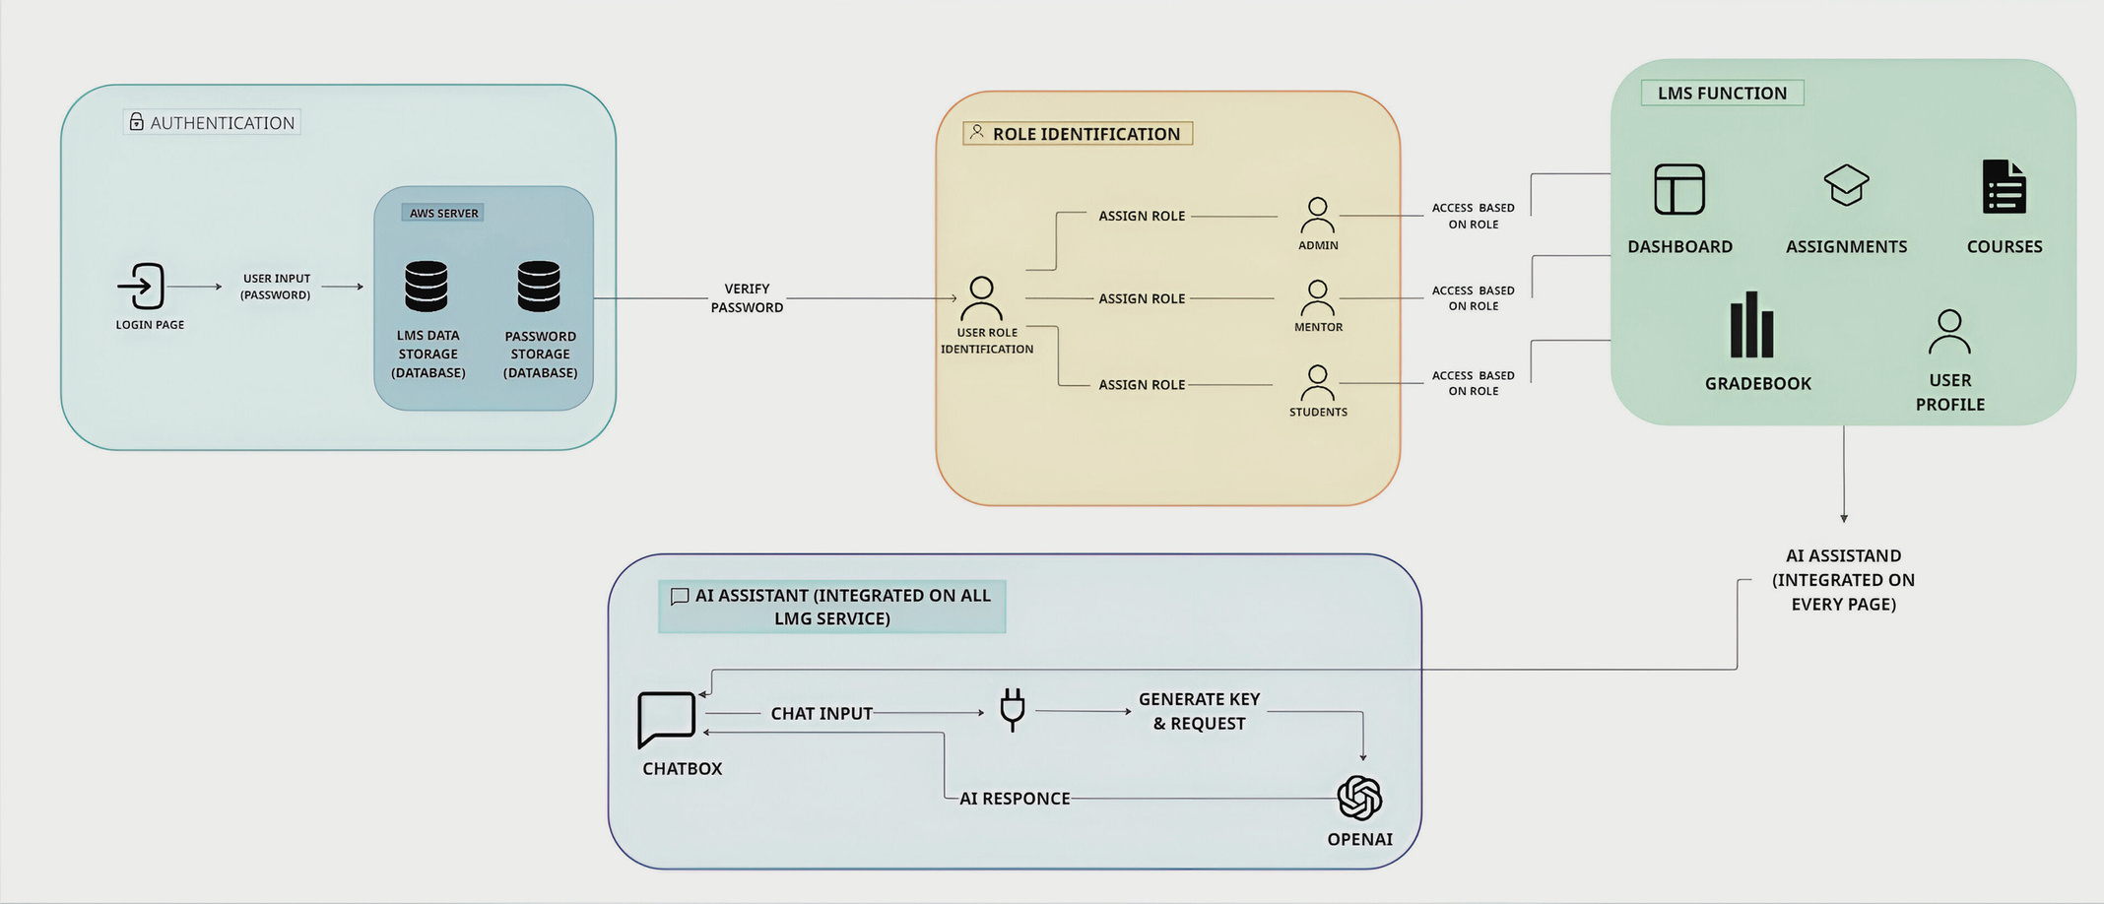

ARCHITECTURAL DIAGRAM
BACK-END/DATABASE
T
s

Slide 11
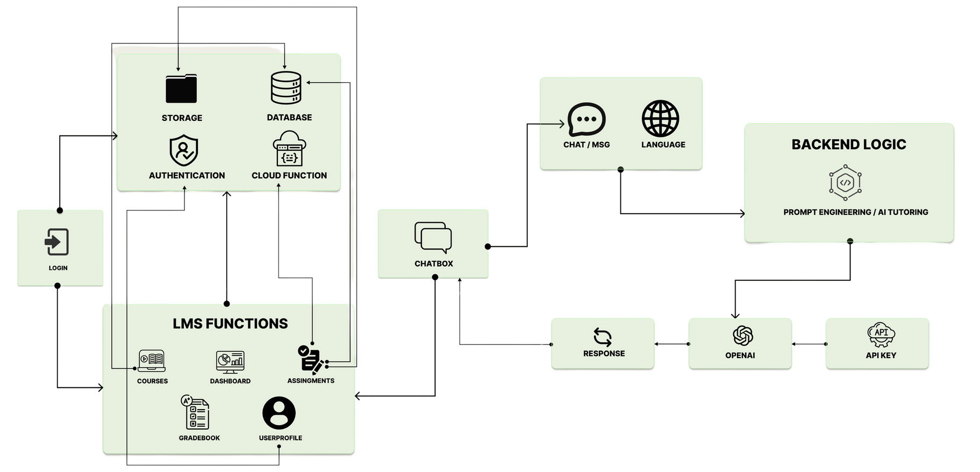
MODULAR DIAGRAM

Slide 12


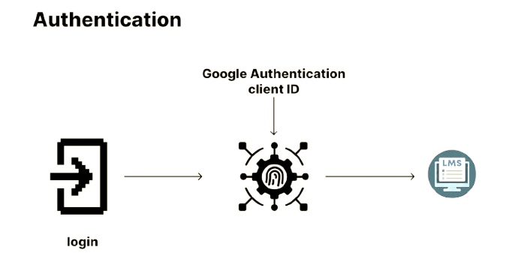

MODULAR DIAGRAM
AUTHENTICATION

Slide 13
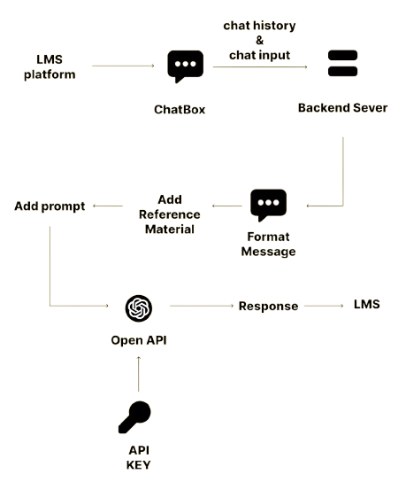
MODULAR DIAGRAM
AI INTEGRATION

Slide 14
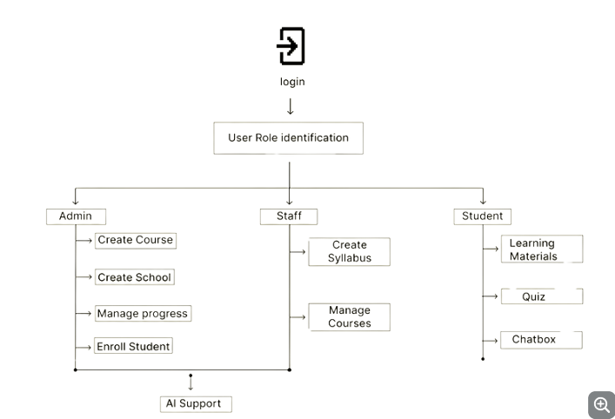


MODULAR DIAGRAM
ROLE IDENTIFICATION AND LMS FUNCTIONS

Slide 15
TECHNIQUES
1. TRANFORMER BASED MODEL (CHATGPT)
Role: Core language understanding and generation engine
These models enable the system to interpret complex user queries and generate clear, contextually relevant responses. Through fine-tuning or prompt guidance, the model produces detailed explanations, answers quiz questions, and engages learners in natural, informative dialogue.
Example: When a learner asks about “recursion in programming,” the transformer model generates a comprehensive, easy-to-understand explanation tailored to the learner’s level.

Slide 16
TECHNIQUES
2. PROMPT TUNING
Role: Direct the model’s output behavior without retraining
Prompt engineering strategically designs inputs to steer the model’s responses based on the context and user intent. This approach efficiently customizes the AI’s behavior for different tasks—such as explaining concepts or evaluating quiz answers—without expensive retraining.
Example: For subjective quiz answers, a prompt might instruct the model to “Assess the response for accuracy and clarity, then provide constructive feedback.”

Slide 17
TECHNIQUES
3. RULE BASED CLASSIFICATION
Role: Identify user intent and message type.
This technique automatically categorizes incoming messages (e.g., learning queries, quiz submissions, feedback) and distinguishes between question types (objective vs. subjective). Accurate classification ensures that user inputs are routed to the appropriate processing module, improving system efficiency and response accuracy.
Example: The system classifies a user’s message as a “quiz submission” and identifies the question as objective, triggering automated scoring.

Slide 18
PSEUDOCODE
def prompt_tuning():
# Step 1: Get input from UI
request = get_request_from_UI()
# Step 2: Extract basic values from request
language = request.language
task_id = request.taskId
message_type = request.messageType
message = request.message
# Step 3: Get reference materials based on task ID
reference_material = get_reference(task_id)
# Step 4: Initialize variables
chat_history = None
system_prompt = " "

Slide 19
PSEUDOCODE
# Step 5: Check message type
if message_type == "learning":
chat_history = request.chatHistory
system_prompt = "<Prompt> + " + language
elif message_type == "quiz":
question_id = request.questionId
question_type = request.questionType
# Get chat history from database
chat_history = get_history_from_DB(question_id, task_id)
# Set system prompt based on question type
if question_type == "objective":
system_prompt = "<Prompt> + " + language

Slide 20
PSEUDOCODE
elif question_type == "subjective":
system_prompt = "<Prompt> + " + language
# Step 6: Call OpenAI API with all inputs
response = openAiCall(
api_key=openApiKey,
message=message,
system_prompt=system_prompt,
chat_history=chat_history,
reference_material=reference_material
)
# Step 7: Return the final response
return response

Slide 21

EXPECTED RESULTS
STUDENT - LOGIN PAGE

Slide 22

EXPECTED RESULTS
STUDENT - PREVIEW OF THE COURSE

Slide 23
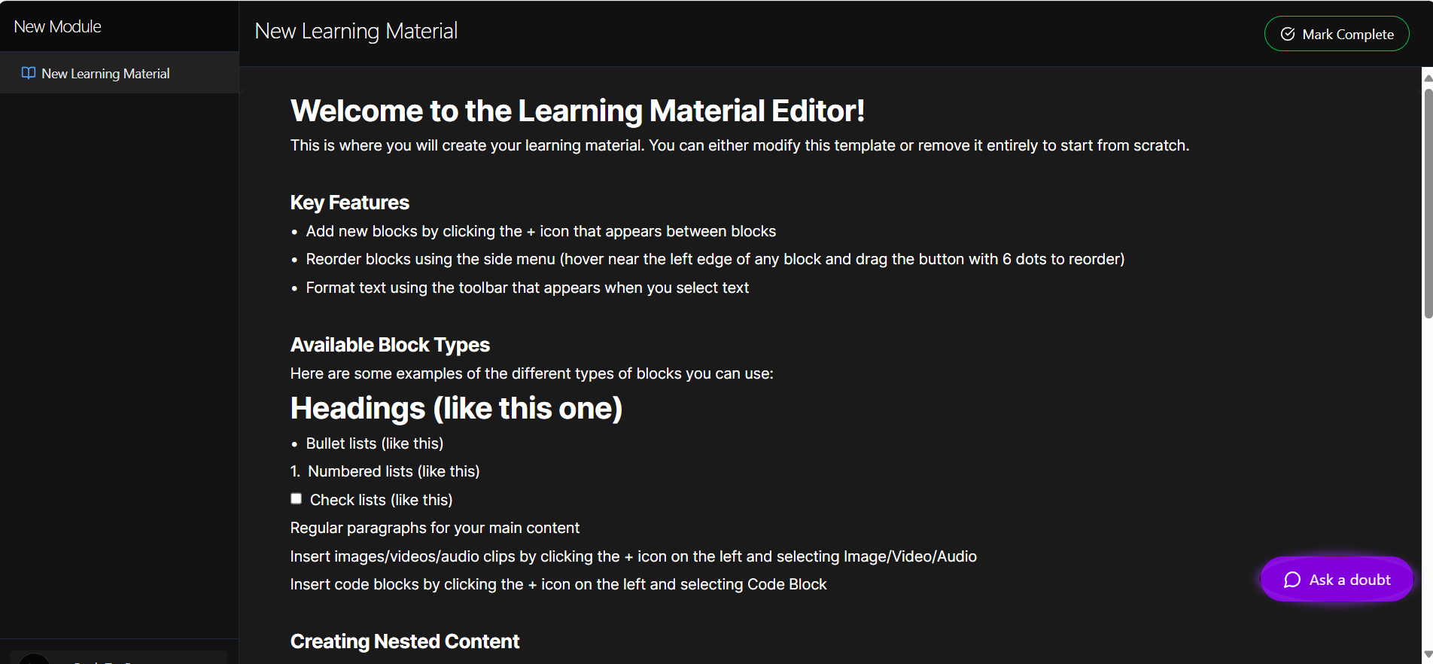
EXPECTED RESULTS
STUDENT - LEARNING MATERIAL

Slide 24
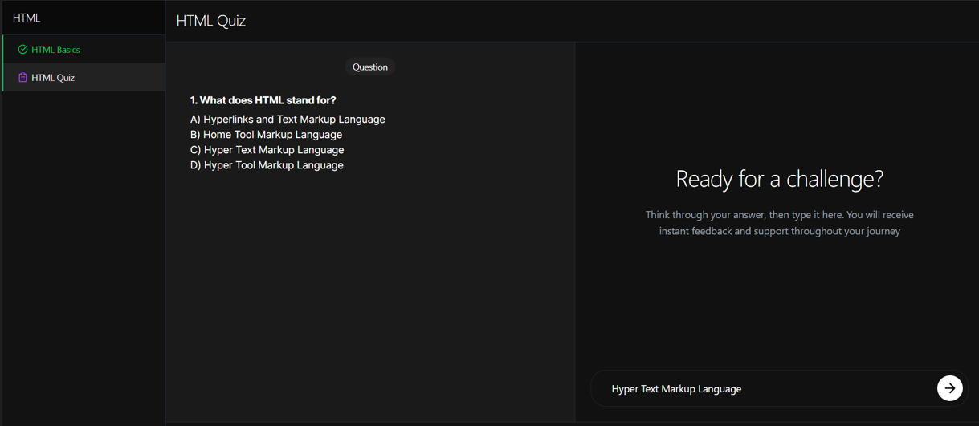
EXPECTED RESULTS
STUDENT - QUIZ MODE

Slide 25
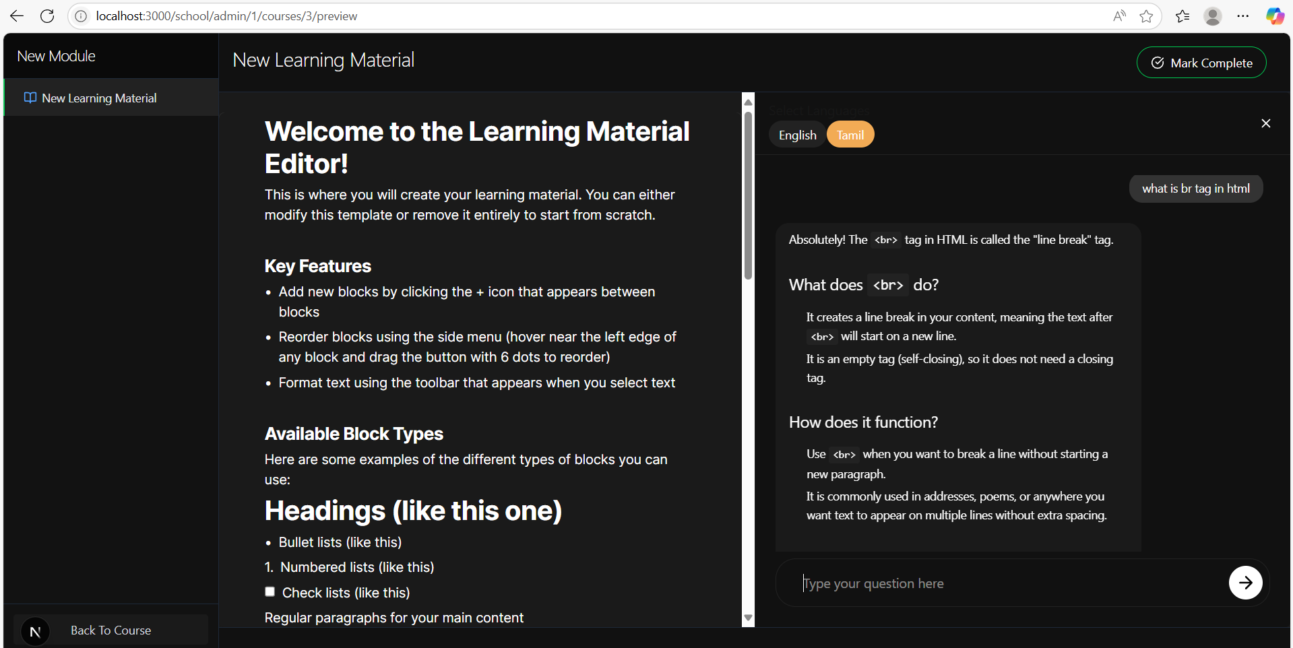
EXPECTED RESULTS
AI ASSISTANCE IN ENGLISH

Slide 26
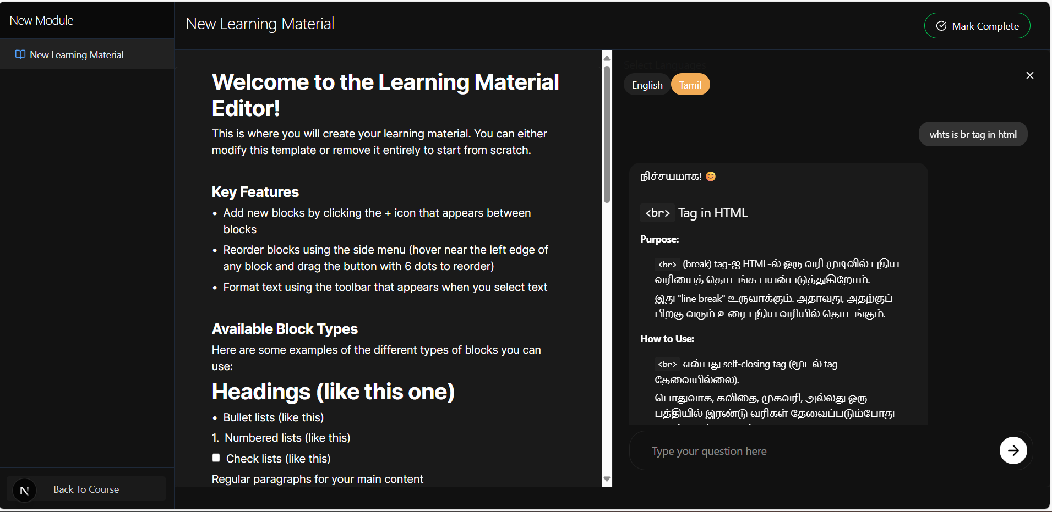
EXPECTED RESULTS
AI ASSISTANCE IN TAMIL

Slide 27
COMPARISON WITH EXISTING SYSTEMS
ASPECT | TRADITIONAL PLATFORMS | PROPOSED SYSTEM
Evaluation Mechanism | Manual or quiz-based evaluation, lacks personalization. | AI-powered task evaluation using NLP and ML models for instant, contextual feedback.
Learning Format | Pre-recorded video lectures, passive learning. | Task-first, active learning with real-time tasks, instant validation, and feedback.
Assistance & Support | Limited to forums or scheduled mentor sessions. | Instant AI assistance using inbuilt AI Coach that explains concepts, errors, and guides improvement.
Adaptability | Fixed curriculum, same for all learners. | Adaptive learning paths based on learner’s performance and AI feedback loops.

Slide 28
Feedback & Improvement | Delayed, generalized feedback (e.g., end-of-course grades). | Granular, real-time feedback after every task using attention maps, code analysis, etc.
Time to Skill | Longer, as learners need to synthesize learning independently. | Shorter, AI-accelerated skill acquisition through hands-on, assisted learning.
Scalability & Cost | Heavy reliance on content creators, high bandwidth and licensing costs. | Open-source, lightweight, easy to deploy in classrooms, institutions, and enterprises.
Personalization | One-size-fits-all course structure. | Dynamic task recommendation based on learner strengths and weaknesses (AI-driven skill graph).
Project Readiness | Courses often end with guided projects, lacking autonomy. | Projects are autonomous, real-world aligned, AI-reviewed, and GitHub-exportable.
Deployment Focus | Academic or certification-oriented, not optimized for deployment. | Designed for skill-to-deployment transition, enabling learners to build deployable outputs quickly.
Interactivity | Mostly watch-and-learn model, low engagement. | AI-curated interactive tasks and simulations improve engagement and concept clarity.

Slide 29
CONCLUSION AND FUTURE WORKS
Our project introduced an AI-powered academic support systemdesigned to overcome the limitations of traditional academic help, such as limited availability and lack of personalization. Built with React.js, FastAPI, and a fine- tuned OpenAI model,the system providesreal-time, subject-specific assistance through a user-friendly interface. Its key features—AI chat, role-based access, and progress tracking—create a seamless learning experience. The modular architecture allows easy integration into existing platforms and reduces educator workload by automating common student queries. In summary, the system effectively delivers on-demand, personalized support, enhancing student learning, engagement, and independence.

Slide 30
While the current version of the system demonstrates promising results, several enhancements can be considered to further improve its functionality, adaptability, and impact:
Voice-enabled AI Assistant: Integrate speech recognition and synthesis to support hands-free interaction and improve accessibility for differently-abled learners.
Emotional Intelligence Integration: Enhance the AI model to detect learners’ emotions and adapt responses accordingly to offer empathetic support.
Real-time Analytics Dashboard: Develop dynamic dashboards for educators to monitor student progress and intervene when necessary.
Gamification Integration: Introduce AI-driven gamified elements to boost engagement and motivation among learners.
Offline Learning Capabilities: Enable AI support features in offline mode to cater to regions with limited internet connectivity.

Slide 31
REFERENCES
[ 1 ] A. Sabar, S. Gamage, S. Abishek, C. Lakmal, K. A. D. T. Kulawansa and P. Perera, "AI-Powered Student Learning System," 2024 8th SLAAI International Conference on Artificial Intelligence (SLAAI-ICAI), Ratmalana, Sri Lanka, 2024
[ 2 ] A. K. Rekha, K. Gopal, D. Satheeskumar, U. A. Anand, D. S. S. Doss and S. Elayaperumal, "Ai-Powered Personalized Learning System Design: Student Engagement And Performance Tracking System," 2024 4th International Conference on Advance Computing and Innovative Technologies in Engineering (ICACITE), Greater Noida, India, 2024,
[ 3 ] Y. Chen, H. Chen and S. Su, "Fine-Tuning Large Language Models in Education," 2023 13th International Conference on Information Technology in Medicine and Education (ITME), Wuyishan, China, 2023,
[ 4 ] J. Divasón, F. J. Martínez-de-Pisón, A. Romero and E. Sáenz-de-Cabezón, "Artificial Intelligence Models for Assessing the Evaluation Process of Complex Student Projects," in IEEE Transactions on Learning Technologies, vol. 16, no. 5, pp. 694-707, Oct. 2023,
M. Z. Li, "Using Prompt Engineering to Enhance STEM Education," 2024 IEEE Integrated STEM Education Conference (ISEC), Princeton, NJ, USA, 2024

Slide 32
REFERENCES
[ 5 ] A. E. Ubah et al., "A Review of Artificial Intelligence in Education," 2022 International Conference on Artificial Intelligence of Things and Crowdsensing (AIoTCs), Nicosia, Cyprus, 2022,
[ 6 ] M. Murtaza, Y. Ahmed, J. A. Shamsi, F. Sherwani and M. Usman, "AI-Based Personalized E-Learning Systems: Issues, Challenges, and Solutions," 2022,
[ 7 ] B. Galhotra and D. Lowe, "AI Based Examination System: A Paradigm Shift in Education Sector," 2022 International Conference on Machine Learning, Big Data, Cloud and Parallel Computing (COM-IT-CON), Faridabad, India, 2022,
[ 8 ] J. Han, J. Lu, Y. Xu, J. You, and B. Wu, "Intelligent Practices of Large Language Models in Digital Government Services," IEEE Access, vol. 12, pp. 8633-8640, Jan. 2024, doi: 10.1109/ACCESS.2024.3349969.
M. Z. Li, "Using Prompt Engineering to Enhance STEM Education," 2024 IEEE Integrated STEM Education Conference (ISEC), Princeton, NJ, USA, 2024

Slide 33
REFERENCES
[ 9 ]B. F. Mon, A. Wasfi, M. Hayajneh and A. Slim, "A Study on Role of Artificial Intelligence in Education," 2023 International Conference on Computing, Electronics & Communications Engineering (iCCECE), Swansea, United Kingdom, 2023
[ 10 ] M. Z. Li, "Using Prompt Engineering to Enhance STEM Education," 2024 IEEE Integrated STEM Education Conference (ISEC), Princeton, NJ, USA, 2024

